Slide 1
Object-Oriented Programming (OOP) Project

Slide 2
GroupMembers:-
Ehsan Saleem 22P-9205
Hamza Khan 22P-9178
Farooq Farooqi 22P-9411

Slide 3
Introduction
Welcome to our Object-Oriented Programming (OOP) project presentation.
Our project revolves around the classic and timeless gaming experience of a Snake Game.

Slide 4
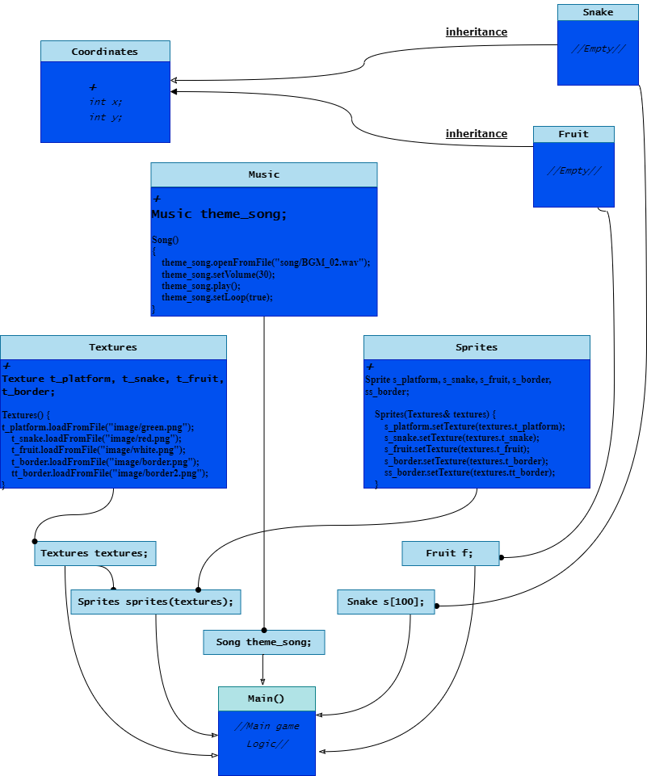

Slide 5
Key components
Snake: The protagonist of our game, controlled by the player's inputs.
Fruit: The target for the snake to consume, contributing to its growth.
Game Environment: The interactive space where the snake maneuvers, filled with boundaries and dynamic elements.

Slide 6
Introduction to SFML
SFML (Simple and Fast Multimedia Library):
A powerful C++ library designed for game and multimedia development.
Functions:
Graphics: Rendering images, textures, and sprites on the screen.
Audio: Handling sound effects and background music.
Significance in Game Development:
SFML streamlines multimedia operations, providing developers with essential tools for creating immersive games.
.
.

Slide 7
SFML Functions - Graphics
SFML Graphics in the Project:
Usage in Snake Game: SFML Graphics facilitates the rendering of game elements.
Key Functions:
Texture Loading: Loading images into the game.
Sprite Creation: Creating movable game entities.
Example:
Loading a snake texture and applying it to the snake object.
.

Slide 8
.
GUI Elements
GUI Elements in the Game:
Platform, Borders, Snake, Fruit:
Key graphical components contributing to the game's visual appeal.
SFML Drawing:
SFML is used to draw and display these elements on the game window.

Slide 9
LEADERSHIP
SFML Functions - Audio
SFML Audio in the Project:
Usage in Snake Game:
SFML Audio manages the game's sound environment.
Implementation of Theme Music:
Background theme music enhances the gaming experience.
Played on a loop throughout the game for continuity.

Slide 10
Object-Oriented Structure
Use of Classes:
Code Organization: Utilizing classes for systematic code structuring.
Classes in the Project:
Coordinates, Song, Textures, Sprites, Snake, Fruit.
OOP Principles:
Encapsulation: Bundling related functionalities within classes.
Reusability: Classes enhance code reuse, promoting efficiency.

Slide 11
Snake Movement Logic
Tick() Function:
Responsible for updating the snake's position.
User Input Handling:
Arrow keys and WASD dictate the direction of the snake's movement.
Timer Usage:
A timer controls the speed of the snake's movement.

Slide 12
Collision Detection
Handling Snake-Fruit Collision:
Triggering growth and repositioning of the fruit.
Border and Self Collisions:
Managing collisions with the game borders and the snake itself.
Game Over Condition:
Resetting the game when specific collision conditions are met.

Slide 13
THANKS.

